Slide 1
Enhancing Industry Interoperability: CAQH CORE Connectivity Operating Rules
July 22, 2020
2:00-3:00 pm EST

Slide 2
Agenda
CAQH CORE Overview and Industry Update
Existing CAQH CORE Connectivity Rule Requirements
CAQH CORE Connectivity Rule Update
Q&A

Slide 3

Logistics
Presentation Slides and How to Participate in Today’s Session
Accessing webinar materials
  You can download the presentation slides now from the “Handouts” section of the GoToWebinar menu.
  You can download the presentation slides and recording at www.caqh.org/core/events after the webinar.
  A copy of the slides and the webinar recording will also be emailed to all attendees and registrants in the next 1-2 business days.
Questions can be submitted at any time using the Questions panel on the GoToWebinar dashboard.
Download the Slides Now
1 of 1
Presentation Slides
3

Slide 4
Speakers
Patrick Murta
Chief Interoperability Architect & Fellow, Enterprise Architecture, Humana
Co-Chair of the CAQH CORE Connectivity & Security Work Group
Robert Bowman
CAQH CORE Director
Emily TenEyck
CAQH CORE Manager

Slide 5

2
CAQH CORE
Overview and
Industry Update
Robert Bowman
CAQH CORE Director

Slide 6
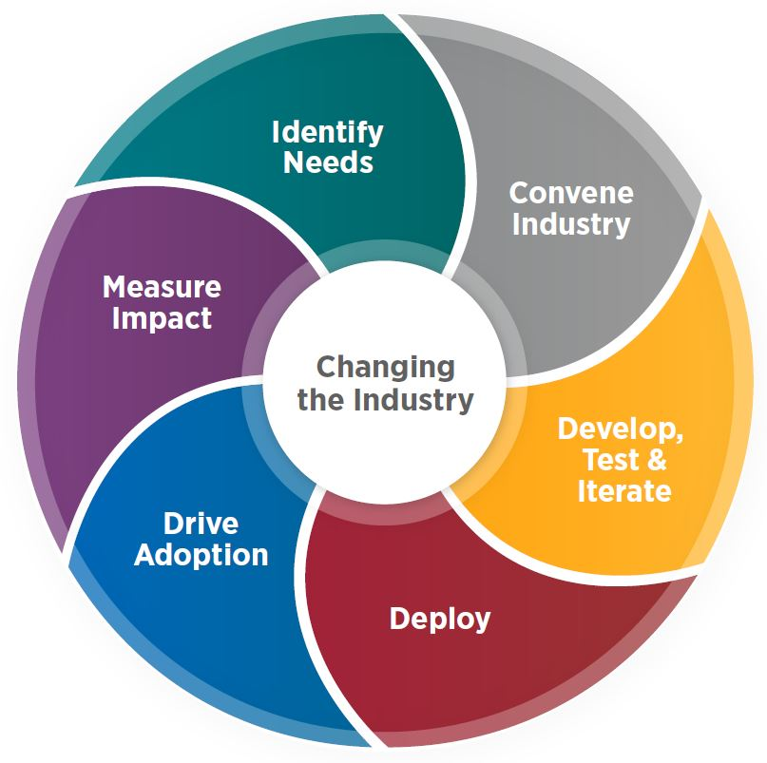
CAQH CORE Mission/Vision & Industry Role
Industry-led, CAQH CORE Participants include healthcare providers, health plans, vendors, government entities, associations and standard-setting organizations. Health plans participating in CAQH CORE represent 75 percent of the insured US population.
MISSION
Drive the creation and adoption of healthcare operating rules that support standards, accelerate interoperability and align administrative and clinical activities among providers, payers and consumers.
VISION
An industry-wide facilitator of a trusted, simple and sustainable healthcare data exchange that evolves and aligns with market needs.
DESIGNATION
CAQH CORE is the national operating rule author to improve the efficiency, accuracy and effectiveness of industry-driven business transactions. The Department of Health and Human Services (HHS) designated CAQH CORE as the author of national operating rules for the HIPAA-covered administrative transactions.
INDUSTRY ROLE
Develop business rules to help industry effectively and efficiently use electronic standards while remaining technology- and standard-agnostic.
CAQH CORE BOARD
Multi-stakeholder. Members include health plans, providers (some of which are appointed by associations such as the AHA, AMA, MGMA), vendors, and government entities. Advisors to the Board include SDOs (X12, HL7, NACHA, NCPDP) and WEDI.
6

Slide 7
CAQH CORE Operating Rule Overview
Infrastructure | Data Content | Other | Connectivity Rule Application
Eligibility & Benefits
Eligibility (270/271) Infrastructure Rule*
Eligibility (270/271) Data Content Rule*
Connectivity Rule vC.1.1.0 (PI)* Connectivity Rule vC.2.2.0 (PII)*
Claim Status
Claim Status (276/277) Infrastructure Rule*
Connectivity Rule vC.2.2.0 (PII)*
Payment & Remittance
Claim Payment/ Advice (835) Infrastructure Rule*
EFT/ERA 835/CCD+ Data Content Rule*
EFT/ERA Enrollment Data Rules*
Prior Authorization & Referrals
Prior Authorization (278) Infrastructure Rule**
Prior Authorization (278) Data Content Rule**
Prior Authorization Web Portal Rule
Connectivity Rule vC.3.1.0 (PIV)**
CAQH CORE is proposing Connectivity Rule vC3.1.0 be adopted to replace existing federal mandates for vC1.1.0 and vC2.2.0 for eligibility, claim status, and ERA transactions.
Rule Set
Health Care Claims
Health Care Claim (837) Infrastructure Rule
Benefit Enrollment
Benefit Enrollment (834) Infrastructure Rule
Premium Payment
Premium Payment (820) Infrastructure Rule
*Indicates rule is federally mandated.
**Indicates rule was proposed in 2020 to NCVHS for federal mandate.
End Goal: Single Connectivity Rule across rule sets

Slide 8
CAQH CORE Rule Package for NCVHS/HHS Consideration
Prior Authorization & Connectivity Operating Rules Increase Value & Use of Electronic Transactions
In February 2020, the CAQH CORE Board sent a letter to NCVHS proposing a CAQH CORE Prior Authorization and Connectivity Operating Rules package for recommendation to the HHS Secretary for national adoption under HIPAA that includes:
  CAQH CORE Prior Authorization & Referrals (278) Data Content Rule vPA.1.0
  CAQH CORE Prior Authorization & Referrals (278) Infrastructure Rule vPA.2.0
  CAQH CORE Connectivity Rule vC3.1.0
The Board proposed this rule package for federal mandate for three reasons:
  The prior authorization operating rules address a pressing need to improve automation and timeliness of the prior authorization process.
  The connectivity operating rule enhances security and promotes uniform interoperability requirements across administrative transactions.
  These operating rules set the stage for future operating rules to further enable the critical convergence of administrative and clinical data and support the use of new technologies with existing standards.
In June 2020, CAQH CORE sent a letter updating NCVHS on the re-structuring of the operating rules and the impact on the proposed rule set.
An NCVHS Hearing on the proposed rule package is scheduled for August 25-26 in Washington, D.C. Public comments may be submitted to NCVHS by July 24.

Slide 9
CAQH CORE Connectivity Roadmap
The CAQH CORE Connectivity Rules address connectivity and security of administrative and clinical data exchange and establish a national base guiding healthcare communication.
Increased Interoperability and Improved Connectivity & Security
Existing
CAQH CORE Connectivity Versions C1 & C2
Federally Mandated for CORE Eligibility and Claim Status Transactions
Standardized transport allowed for greater online access due to uniformity in transport protocols.
Requirements were developed more than ten years ago; no longer align with industry best practices for connectivity and security.
CAQH CORE will sunset vC1 and vC2 if vC3 is federally mandated.
Currently Before NCVHS
CAQH CORE Connectivity Version C3
Applies to all transactions currently addressed by CAQH CORE Operating Rules
CAQH CORE has proposed vC3 for federal mandate to replace vC1 and vC2 for eligibility, claim status and ERA and support prior authorization.
Mandate would create a base connectivity protocol across all transactions; requires single transport & envelope standard, robust authentication and security standards and specific metadata.
Future Update
CAQH CORE Connectivity Version C4
Under Development
Will Apply to all transactions addressed by CAQH CORE Operating Rules including claim and PA attachments.
Supports clinical and administrative data exchange. Updates and aligns CAQH CORE connectivity & security requirements to support REST and other API technology.
CAQH CORE Board may propose future updates to the federally mandated connectivity requirements to align with vC4.
CAQH CORE Participants will continue to update and maintain the Connectivity Rule at regular intervals over time to align with current interoperability, privacy and security standards.

Slide 10
2
Existing CAQH CORE Connectivity Rule Requirements
Emily TenEyck
CAQH CORE Manager

Slide 11
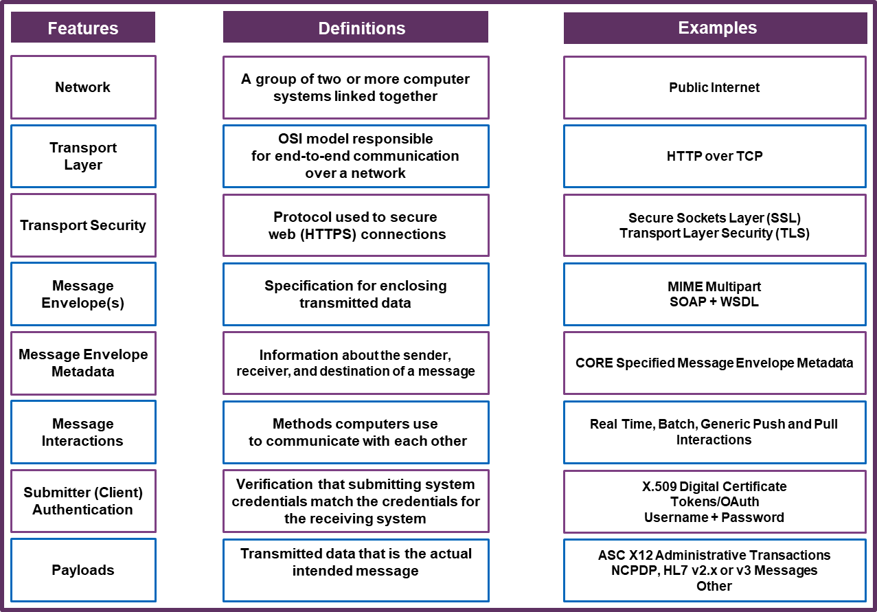
CAQH CORE Connectivity
Key Features & Definitions
Connectivity
Generic term for connecting devices such as computers, information systems or networks to facilitate data access and exchange.
Addresses a variety of protocols and standards.
The healthcare industry employs a variety of communication modes, each of which has its own protocols or standards.

Slide 12
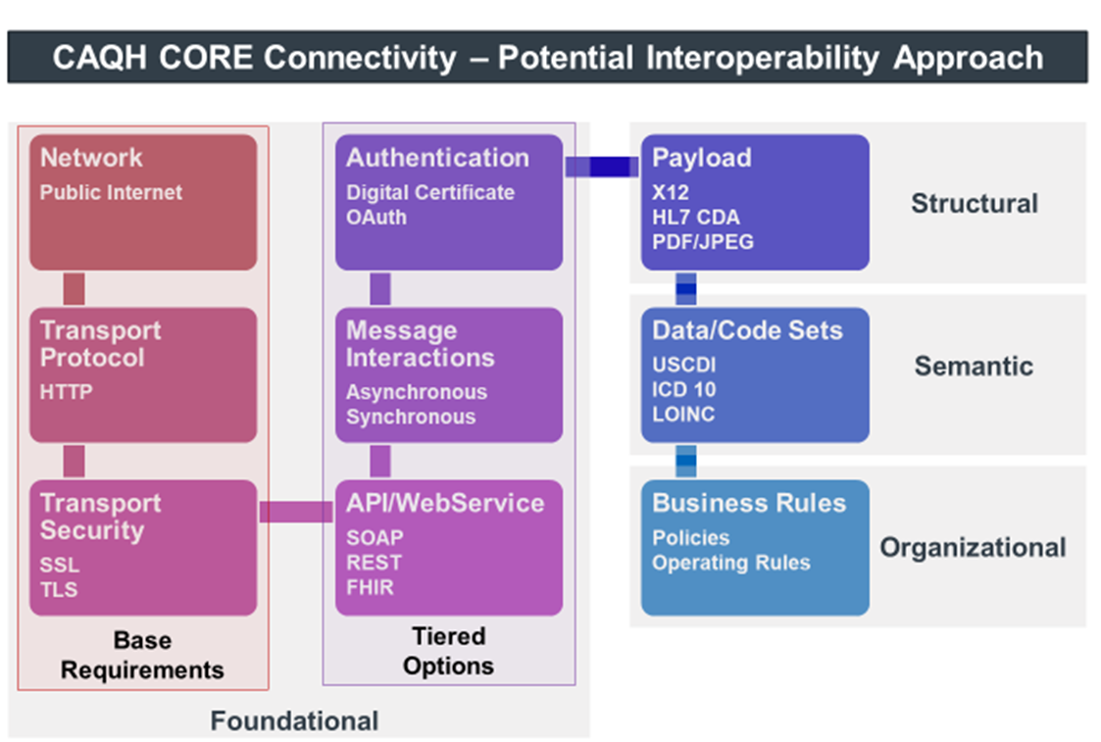
CAQH CORE Connectivity to Advance Interoperability
Connectivity enables the transport of information to support data exchange.
Health information technology interoperability is characterized by the needs and opportunities of a particular segment of the data exchange:
Foundational interoperability is the capability of a system to transfer data to and from another system.
Structural interoperability refers to the capacity to preserve the original composition or syntax of healthcare data as it moves between systems.
Semantic interoperability is the ability of two or more systems to enter a data exchange and use the information transferred -- leverages data structure against a common vocabulary.
Organizational interoperability refers to the policies and governance needed to support the smooth exchange of data.

Slide 13
Evolution of CAQH CORE Connectivity Requirements
Rule Evolved to Align with Industry Best Practices for Security and Connectivity
Given large install base of vC2.2.0 due to current federal mandates, implementation costs for vC.3.1.0 will be limited due to commonalities in transport, envelope, authentication standards, and metadata. Implementation costs may be further reduced given the single submitter authentication standard.
Connectivity Rule Area | CAQH CORE Connectivity vC.1.1.0 | CAQH CORE Connectivity vC.2.2.0 | CAQH CORE Connectivity vC.3.1.0
Network | Internet | Internet | Internet
Transport | HTTP | HTTP | HTTP
Transport Security | SSL | SSL 3.0 with optional use of TLS 1.x | SSL 3.0, or optionally TLS 1.1 or higher Entities that must also be FIPS 140-2 compliant or that require stronger transport security may implement TLS 1.1 or higher in lieu of SSL 3.0
Submitter (Originating System or Client) Authentication | Name/Password | UserName + Password OR X.509 Digital Certificate | X.509 Digital Certificate based authentication over SSL/TLS Removed Username + Password
Envelope and Attachment Standards | Unspecified | SOAP 1.2 + WSDL 1.1 and MTOM (for Batch) OR HTTP+MIME | SOAP 1.2 + WSDL 1.1 and MTOM (for both Real Time and Batch) Removed HTTP+MIME
Envelope Metadata | Unspecified | Metadata defined (Field names, values) (e.g., PayloadType, Processing Mode, Sender ID, Receiver ID) | Metadata defined (Field names, values) (e.g., PayloadType, Processing Mode, Sender ID, Receiver ID) SHA-1 for Checksum FIPS 140-2 compliant implementations can use SHA-2 for checksum.
Message Interactions/ Routing | Real-time Batch (Optional if used) | Real-time Batch (Optional if used) | Batch and Real-Time processing requirements defined for each transaction Generic push and pull interactions
Acknowledgements, Errors | Specified | Enhanced vC1.1.0, with additional specificity on error codes | Errors Codes updated
Basic Conformance Requirements for Client/Server Roles | Minimally specified | Well specified | Well specified
Response Time | Specified | Maintained vC1.1.0 time requirements | Maintained vC1.1.0 time requirements
Connectivity Companion Guide | Specified | Enhanced vC1.1.0, with additional recommendations | Enhanced vC1.1.0, with additional recommendations

Slide 14





Benefits of CAQH CORE Connectivity vC.3.1.0 over vC.2.2.0
Single standard: Reduces complexity and simplifies interoperability by requiring the SOAP + WSDL envelope standard and establishes more robust and uniform support for handling transaction payload by requiring MTOM for SOAP for both real time and batch processing modes.
Improved Security: By requiring use of X.509 Client Certificate-based authentication and removing the security vulnerable username + password, implementors benefit from a more robust and industry standard security. Additionally, provides support for FIPS 140-2 compliance for entities requiring such compliance, in terms of transport security and message envelope security.
Additional transaction standard support: Provides support for additional transactions relative to the previous rules, including prior authorization in addition to eligibility, claim status, and electronic remittance advice.
Safe Harbor: The CAQH CORE Connectivity safe harbor specifies that application vendors, clearinghouses, providers, and health plans can be assured CAQH CORE Connectivity will be supported by any HIPAA covered entity and/or a CORE-certified entity, meaning the entity is capable and ready at the time of the request by a trading partner to exchange data using the CAQH CORE Connectivity Rule. The rule does not require entities to remove existing connections. For example, while the X.509 digital certificate must be used if requested by a trading partner, the rule clearly state there is no requirement to use a CAQH CORE-compliant method if trading partners agree to use different security requirements, e.g., a virtual private network (VPN) or secure file transfer protocol (SFTP).
Improves Messaging and Error Reporting: Enhances the communication of errors with updated error codes.

Slide 15
CAQH CORE Connectivity
Safe Harbor Principle
Using the Internet as a delivery option establishes a Safe Harbor connectivity method that application vendors, providers, and health plans can be assured will be supported by any HIPAA covered entity, meaning that the entity is capable and ready to exchange data at the time of a request by a trading partner using the CAQH CORE Connectivity Rule.
CORE Connectivity (Safe Harbor)
The Safe Harbor connectivity method enables trading partners to:
Use different communications & security methods than what is specified in rule
Does not require discontinuation of any existing connectivity methods that do not conform with CAQH CORE Operating Rules.
Trading Partners with CORE Connectivity
CORE
Conformant
Entity
Other Connectivity Approaches
Trading Partners with other Connectivity Approaches

Slide 16
Polling Question #1
Which CAQH CORE Connectivity benefits are most important to your organization? (Select all that apply)
Reduces Complexity (Single Standard)
Improved Security
Additional Transaction Standard Support
Safe Harbor
Improved Messaging and Error Reporting

Slide 17
2
CAQH CORE Connectivity Rule Update
Patrick Murta
Chief Interoperability Architect & Fellow, Enterprise Architecture, Humana
Co-Chair of the CAQH CORE Connectivity & Security Work Group

Slide 18
CAQH CORE Connectivity Update
Aligning Connectivity Requirements to Support Industry Advancement
CAQH CORE Connectivity Rule Update Goals:
Align the CAQH CORE Connectivity Rule to support frameworks proposed in the CMS and ONC interoperability rules and modernize the CORE Connectivity Requirements.
Establish a Safe Harbor that aligns with existing IT implementations and supports emerging approaches for exchanging data.
Develop a CAQH CORE Connectivity Rule that support the intersection of administrative and clinical data exchange.
Specific Draft Connectivity & Security Requirement Updates:
Require the use of public internet and web services for connectivity and TLS v1.2 or higher for security.
Define submitter authentication and authorization methods to establish trust within an attachment exchange such as X.509 Digital Certificates and OAuth 2.0.
Add support for REST APIs and the exchange of Attachments transactions.

Slide 19

CAQH CORE Connectivity & Security Work Group Roadmap
We are here
2020
Feb
Mar
Apr
May
Jun
July
Aug
Sept
Oct
Nov
Dec
Connectivity & Security Work Group Drafts Requirements for CAQH CORE Connectivity Rule Update
Formal CAQH CORE Voting Process
CSWG Chooses Rule Requirements for Update
CSWG Drafts
Updated Connectivity Rule Requirements
CSWG Finalizes & Ballots Updated Connectivity Rule
Final CORE Participant Vote
CSWG Recruitment
CSWG Launches
CORE Board
Vote
NOTE: Timeline may be subject to adjustments based on Work Group needs. New connectivity rule will support/align with other new operating rules developed in 2020/2021, (e.g. attachments, value-based payments) per the CAQH CORE Roadmap.

Slide 20
Provide for Updated, Consistent Connectivity Modes for Data Exchange
  CAQH CORE proposed to NCVHS that the CAQH CORE Connectivity Rule vC.3.1.0 replace current regulations mandating support for CAQH CORE Connectivity Rules vC.1.1.0 and vC.2.2.0 for the eligibility and benefits, claim status, and electronic remittance advice transactions in addition to prior authorization, to promote uniform interoperability requirements across administrative transactions.
Proposed to NCVHS: CAQH CORE Connectivity Rule vC.3.1.0
Establishes a Safe Harbor Connectivity Method that drives industry alignment by converging on common Connectivity standards and requirements.
Under Development: Draft CAQH CORE Connectivity Rule vC.4.0.0
The updates to CORE Connectivity will serve as a bridge between the existing and emerging standards and protocols to ensure industry interoperability needs are met.
Key Existing Connectivity Requirements:
Support for Simple Object Access Protocol (SOAP)* based web services with specific metadata, message structure, and error handling
Use of HTTPS* (SSL 3.0, or optionally TLS 1.1 or higher for compliance with FIPS 140-2 TLS 1.1 or higher in lieu of SSL 3.0) over the Public Internet TCP/IP*
Establishes a Safe Harbor Connectivity Method*
X.509 Digital Certificate Submitter Authentication (mutual authentication)*
* Continue to be supported in the Draft CAQH CORE Connectivity Rule vC4.0.0
Updates to Existing CORE Connectivity Requirements Under Consideration:
Add support for the exchange of Attachments transactions
Specify TLS 1.2 or higher for security
Add OAuth 2.0 as an authorization standard
New REST Requirements Under Consideration:
Support for Representational State Transfer (REST) style web resources for X12 and non-X12 exchanges.
Use of JSON to exchange REST messages
Support for specific HTTP Methods (e.g. POST and GET)
Support for REST API and CORE Connectivity Rule Versioning
Specify API Endpoint Naming Conventions
  Future Connectivity Opportunities: Once a single Connectivity Rule is established across all CAQH CORE operating rule sets, CAQH CORE Participants will continue to update the rule to align with current interoperability, privacy and security standards.
Notes:
Talking point about how all of these can be tested via the Pilot Initiative.

Slide 21
Polling Question #2
Does your organization use RESTful APIs for data exchange?
Yes
No
No, but plan to implement

Slide 22

Audience Q&A
Please submit your questions
Enter your question into the “Questions” pane in the lower right-hand corner of your screen.
You can also submit questions at any time to CORE@caqh.org
Download a copy of today’s presentation slides at caqh.org/core/events
  Navigate to the Resources section for today’s event to find a PDF version of today’s presentation slides.
  The slides and webinar recording will be emailed to all attendees and registrants in the next 1-2 business days.

Slide 23







Healthcare administration is rapidly changing.
Collaborate across stakeholder types to develop operating rules.
Present on CAQH CORE education sessions.
Engage with the decision makers that comprise 75% of the industry.
Represent your organization in work groups.
Join Us
Drive the creation of operating rules to accelerate interoperability
Influence the direction of health IT policy
Click here for more information on joining CAQH CORE as well as a complete list of Participating Organizations.

Slide 24

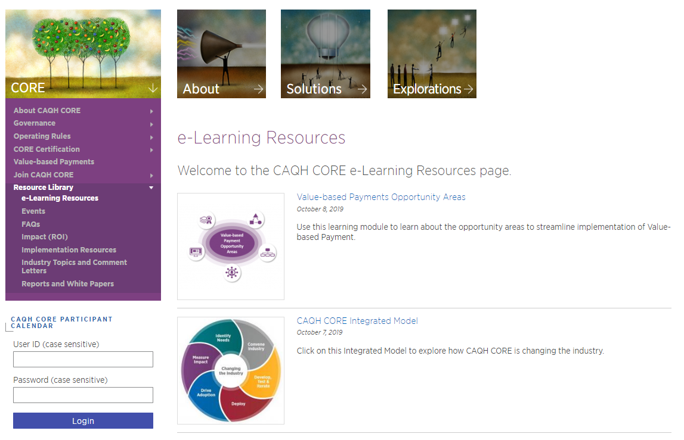
Resource Library
CAQH CORE
Utilize our interactive online tools to learn more about the CORE Certification process and the CAQH CORE model.
Explore our YouTube page to access over 75 CAQH CORE tutorials and webinar recordings.
Listen to a tutorial on the Phase V Operating Rules.
Go to our FAQs page for answers to questions on topics such as operating rule implementation and CORE Participation.
Read our latest white paper “The Connectivity Conundrum: How a Fragmented System is Impeding Interoperability and How Operating Rules Can Improve It.”

Slide 25


Upcoming CAQH CORE Education Sessions and Events
WEDI Forum
August 4-6, 2020
Prior Authorization Case Study Webinar
August 17 | 2:00-3:00 pm EST

Slide 26

Thank you for joining us!
@CAQH
Website: www.CAQH.org/CORE
Email: CORE@CAQH.org
The CAQH CORE Mission
Drive the creation and adoption of healthcare operating rules that support standards, accelerate interoperability and align administrative and clinical activities among providers, payers and consumers.

