Slide 1

2024 CAQH Index Report Webinar
From Transactions to Trust: Building Better
Care Through Healthcare Automation
March 12, 2025

Slide 2
Webinar Logistics
Today’s session is being recorded. All attendees and registrants will receive a link to the recording after the webinar.
Your microphones will be muted during the webinar.
Throughout the session, you may communicate a question via the panel at the bottom of your screen:

Slide 3

2024 CAQH INDEX REPORT WEBINAR
About the CAQH Index Report
Introductions
Panel Discussion Cost Savings Opportunity Impact Challenges with Automating Administrative Transactions Best Practices for Electronic Implementation Closing the Automation Gap
Audience Q & A
Call to Action
March 12, 2025

Slide 4
Tracking transactions across the administrative workflow
2024 CAQH INDEX REPORT
Patient Encounter
is Scheduled
Patient Sees Provider
Provider Submits Claim
Health Plan Adjudicates Claim
Provider is Paid by Health Plan and/or Patient
Eligibility and Benefit
Verification
Prior Authorization
Claim Submission
Attachments
Coordination of Benefits
Claim Status Inquiry
Claim Payment
Remittance Advice
Acknowledgements
Note: This diagram illustrates the administrative workflow in its simplest form.
In practice, some transactions may occur multiple times or in multiple steps and triggered by other events.

Slide 5
$20B industry savings opportunity remains
2024 CAQH INDEX REPORT
The healthcare industry:
31,522
Spent
Transaction Volume
$90 billion
on administrative tasks
Avoided spending
$222 billion
10,422
on administrative tasks through automation
4,398
1,714
2,676
272
Can save an additional
$20 billion
annually through automation
Notes:
plans have more elec workflows in place/are utilizing more elec workflows. have greater access to technology etc.
the costs only include labor time to conduct the tranx. does not include time/cost associated w gathering info or f/u. does not include system costs
for PA - the cost includes the request from the provider to the plan to obtain authorization for a service OR the response from the plan for an auth. referrals are not included. Our costs/times are lower than those reported by an MGMA given we focus solely on this component of the PA process. This is how the 278 is defined. For measurement purposes the tasks were defined as per the HIPAA definition
Clarity on the #s – Of the 8 tasks we measured, total spend is 90B. We believe there is an additional 20B savings of the 90B. Overall 222B has been avoided because of the automation.

Slide 6
Health plan adoption of fully electronic transactions
2020 – 2024 TREND
Medical Plans
N/R = Not Reported
Dental Plans
2020
2021
2022
2023
2024

Slide 7
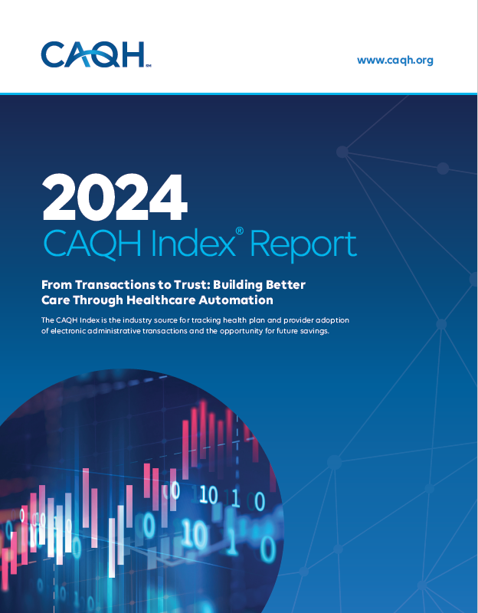




Increasing the visibility, readership, and use of the CAQH Index
2024 CAQH INDEX WEBINAR
Panelists
Laura Cooley, PhD
Editor in Chief,
Journal of Patient Experience
Sofia Fayazdeen
Product Director, Provider Digital EDI UnitedHealthcare
Rebekah Fiehn
Director,
Dental Benefits, Coding, and Data Exchange
American Dental Association
Robert M. Tennant, MA
Executive Director,
WEDI
Notes:
Survey and Data Collection
Goal: To provide more insights to the industry and position CAQH as a thought leader
Supplemental Questions (incorporated into subsequent issue briefs)
Impact of Change HealthCare cyber attack on administrative processes
Use of AI for administrative and clinical tasks
Electronic Prior Authorization (ePA) readiness
Challenges associated with automating administrative workflows
Provider Interviews
NORC conducted 31 interviews with medical and dental providers and staff to gain a greater understanding of:
How they conduct administrative transactions; steps completed during the process
Best practices
Challenges encountered
Reporting & Outreach
Goal: To increase the visibility, readership and use of the report and CAQH within the industry.
Inclusion of the provider and patient perspective
Provider quotes bring findings “to life” make them more relatable; humanize the report
Highlight how findings impact patient along their care journey
Creation of a stand-alone Executive Summary
To increase and improve outreach among new audiences and media
Use simpler, plainer text to explain findings and insights
Panel webinar to share findings with the industry
Replaces the traditional webinar conducted in the past
Interactive, stakeholders present insights and experiences
Report launch party at ViVE
Garner excitement around the report; promote engagement and participation
Showcase that CAQH is THE industry source for this information

Slide 8
Audience Poll Question
How do you plan to use the 2024 Index data and findings? (Select all that apply)
Policy research
Academic research
Business case development / ROI analysis
Workflow implementation
Government and regulatory compliance
Marketing / PR
Other

Slide 9
Audience Q & A
2024 CAQH INDEX WEBINAR

Slide 10

Call to Action
2024 CAQH INDEX WEBINAR
Download the 2024 CAQH Index
The CAQH Index is the industry source for tracking health plan and provider adoption of electronic administrative transactions and the opportunity for savings.
Be part of the 2025 CAQH Index
We invite medical and dental plans, healthcare providers, and vendors to contribute to the CAQH Index. Data collection begins Summer 2025.
Access Webinar Materials
The recording from today’s call will be shared via email and made available on our website.
Explore Industry Research
Review CAQH's latest reports to gain a deeper understanding of industry opportunities, process automation and more.
Download the
report here.
Register here to get information about participating.
Review CAQH’s
latest reports here.
For more information, email insights@caqh.org

Slide 11
INTERNAL USE: Panel Discussion Questions
2024 CAQH INDEX WEBINAR
 | Intro/About Index (Erin) |  | 4 mins
 | I’d like each of you to take a few minutes to introduce yourself and indicate why the Index is important to you? What do you use it for? [Audience POLL QUESTION about use] | 2 mins each | 8 mins
 | A big finding from the Index is that there is still a 20B savings opportunity. How would achieving this savings impact your organization/stakeholders? | 2 mins each | 8 mins
 | I’d like to hear from each of you what are the challenges stakeholders like yourself face when automating administrative processes? | 2 mins each | 8 mins
 | What best practices can you share related to automating administrative processes? | 2 mins each | 8 mins
 | Closing: From where you sit, in the short term what can be done from an industry perspective to help close the automation gap? In the long term? | 3 mins each | 12 mins
 | Questions |  | 6 mins

Slide 12
INTERNAL USE: Panel FILLER Questions
2024 CAQH INDEX WEBINAR
[LAURA] | In discussions about healthcare efficiency, we often focus on providers and payers. What does administrative simplification look like from a patient’s perspective, and how can the industry ensure that efforts to streamline processes don’t inadvertently create new barriers for patients?
[ALL] | One key challenge patients face is the lack of transparency in cost estimates, coverage, and claims processing. How can we leverage data from the Index to advocate for greater transparency and build patient trust in the healthcare system?
[LAURA] | Given your focus in patient care, what policy or industry changes do you believe would have the greatest impact in reducing administrative friction for patients?
[ROB] | Given your focus on regulation, what policy or industry changes do you believe would have the greatest impact in reducing administrative friction?
[REBEKAH] | Given your focus in the dental industry, what policy or industry changes do you believe would have the greatest impact in reducing administrative friction for the dental industry?
[SOFIA] | Given your focus, what policy or industry changes do you believe would have the greatest impact in reducing administrative friction for health plans?

Slide 13
INTERNAL USE: SEED Questions (from Audience Members)
2024 CAQH INDEX WEBINAR
[SOFIA/ REBEKAH] | Please identify the top three opportunities health plans have to reduce administrative waste, ease provider burden, and improve patient access to care, and explain as precisely as possible the actions health plans should take to successfully utilize these three opportunities. (Blue Cross and Blue Shield Association)
[ROB/ERIN] | What additional new changes / outcomes should be looking out for with regards to the No Surprise Act, or other possible changes in the Healthcare system? And is CAQH keeping aware of them? (Credential That LLC)
[] | X
[] | X
[] | X
[] | X

