Slide 1



2025
CAQH Index Webinar
Recovery by the Numbers: Administrative Resilience After a Systemwide Disruption
Thank You to Our Thought Partner
March 19, 2026
© 2026 CAQH, All Rights Reserved.

Slide 2

Webinar Logistics
Today’s session is being recorded. All attendees and registrants will receive a link to the recording after the webinar.
Your microphones will be muted during the webinar.
Throughout the session, you may communicate a question via the panel at the bottom of your screen:

Slide 3

About the 2025 CAQH Index Report
2025 Index Pro Demo
Panel Discussion Value of Index and Index Pro Industry Resilience Leveraging AI Beyond Compliance: Driving Interoperability
Audience Q & A
Call to Action
March 19, 2026

Slide 4

Tracking transactions across the administrative workflow
2025 CAQH INDEX REPORT
Patient Encounter
is Scheduled
Patient Sees Provider
Provider Submits Claim
Health Plan Adjudicates Claim
Provider is Paid by Health Plan and/or Patient
Eligibility and Benefit
Verification
Prior Authorization
Claim Submission
Attachments
Coordination of Benefits
Claim Status Inquiry
Claim Payment
Remittance Advice
Acknowledgements*
*The reporting of Acknowledgements has been retired after achieving consistent 100% electronic adoption. Data is included in total volume for trend analyses
Note: This diagram illustrates the administrative workflow in its simplest form. In practice, some transactions may occur multiple times or in multiple steps and triggered by other events.

Slide 5
$21B industry savings opportunity remains
2025 CAQH INDEX REPORT
The healthcare industry:
Spent
Avoided spending
Can save an additional
$82 billion
$258 billion
$21 billion
on administrative tasks
on administrative tasks through automation
annually through automation

Slide 6
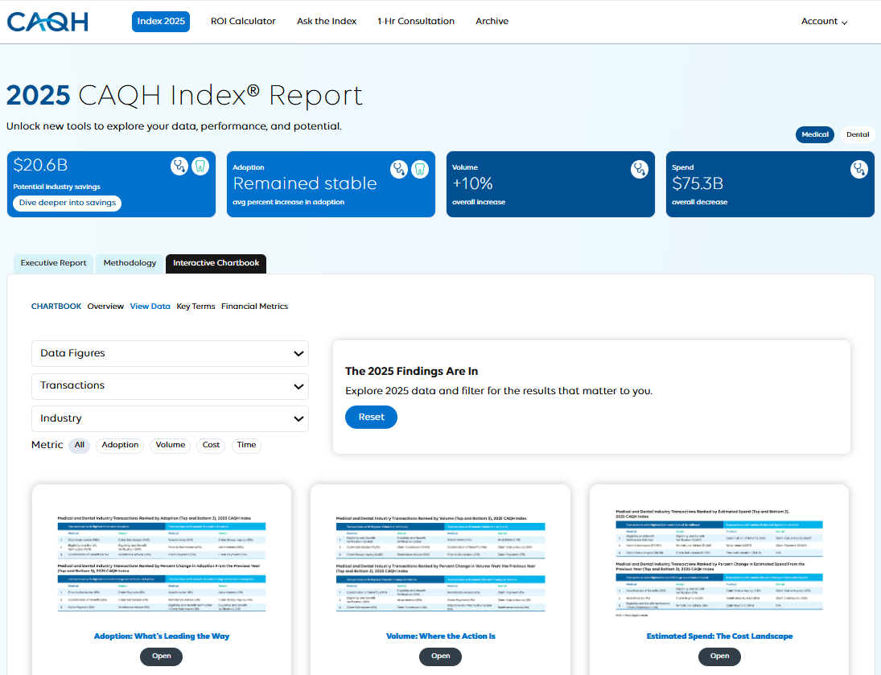
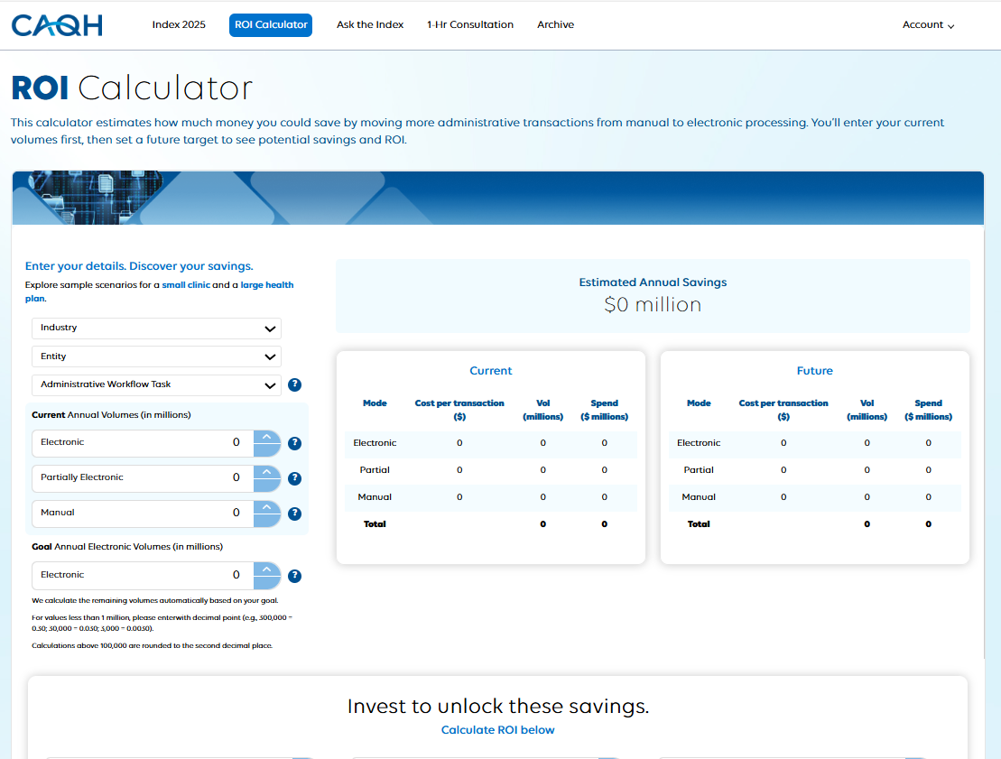
2025 CAQH INDEX REPORT
2025 Index Pro Demo

Slide 7



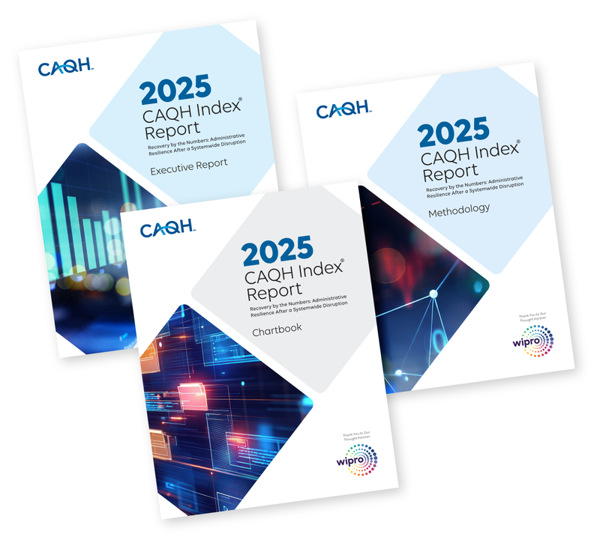
2025 CAQH INDEX REPORT
How Index Pro insights drive strategy, ROI, and automation
Panelists
Tom Cassels
Managing Director
Manatt Health
Pamela T. Johnson, MD, FACR
Attending Radiologist Memorial Sloan Kettering Cancer Center
Matthew McCormick
VP, Growth Strategy
TALON

Slide 8
Audience Poll Question 1
2025 CAQH INDEX REPORT
How do you see your team using Index Pro to drive savings and smarter decisions? Select all that apply.
Calculate real-world ROI for performance improvement strategies and stronger business cases with the ROI Calculator
Benchmark automation performance using the Interactive Chartbook filters
Analyze the impact of administrative workflow inefficiencies by exploring the Interactive Chartbook’s data insights
Get fast, clear data interpretation from Ask the Index AI
Shape and refine strategy through a 1-hr advisory session with CAQH industry SMEs
Something else? Drop it in the chat.

Slide 9
Audience Poll Question 2
2025 CAQH INDEX REPORT
What do you see as the biggest barrier to accelerating electronic adoption today? Select one.
Limited visibility into ROI or unclear business case
Interoperability challenges across systems
Workflow disruption or operational complexity
Vendor or technology limitations
Regulatory uncertainty or shifting requirements
Lack of alignment among stakeholders
Other

Slide 10
Audience
Q&A

Slide 11

To schedule a demo of Index Pro, email insights@caqh.org.
Turn Insight into ROI with Index Pro
Access interactive analytics, on-demand ROI tools, and expert support available only in Index Pro.
Visualize what’s possible. Explore an interactive chartbook with transaction-level and financial data.
Quantify your savings. Use the ROI calculator to uncover your real cost-reduction opportunities.
Get tailored support. Tap into 1-hour of consulting to shape your automation strategy.
Stay ahead. Access emerging data on FHIR, interoperability, and AI before anyone else.
Click here to start your Index Pro experience.

Slide 12


CAQH Insights identifies opportunities to streamline business practices and measure the impact of a more automated healthcare workflow through industry research and partnerships.
Participate in the CAQH Index
We invite medical and dental plans, healthcare providers and vendors to contribute to the CAQH Index. Data collection begins Summer 2026. For more information and to participate, please email insights@caqh.org.
© 2026 CAQH, All Rights Reserved. Confidential and Proprietary.

